Slide 1

DevOps
Software Engineering
By Jenice Mario

Slide 2

Course overview
What is DevOps
Phases of the DevOps Cycle
Benefits

Slide 3

De
What Is DevOps
Definition: “a set of practices, tools, and a cultural philosophy that automate and integrate the processes between software development and IT teams. It emphasizes team empowerment, cross-team communication and collaboration, and technology automation.”
https://www.atlassian.com/devops
Notes:
According to Atlassian. The movement began around mid 2000s when separate teams were a thing and it would’ve been smarter to incorporate

Slide 4

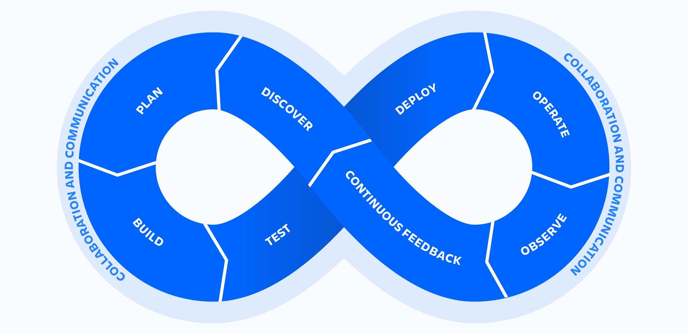
Let’s Dive In
https://www.atlassian.com/devops

Slide 5

The PHASES
Create/Design/Discover
Plan
Build
Test/Package: CI
Deploy/Release: CD
Operate
Observe/Monitor
Continuous Feedback
Professor Kilgallin Lecture 3

Slide 6

Benefits
Quality of Product
Quicker product releases
Reliability
Decreased inefficiencies
Faster bug fixes/issues addressed
https://www.synopsys.com/glossary/what-is-devops.html#A
https://www.atlassian.com/devops
https://www.netapp.com/devops-solutions/what-is-devops/

